Slide 1
Design Patterns and SOLID Principles

Slide 2
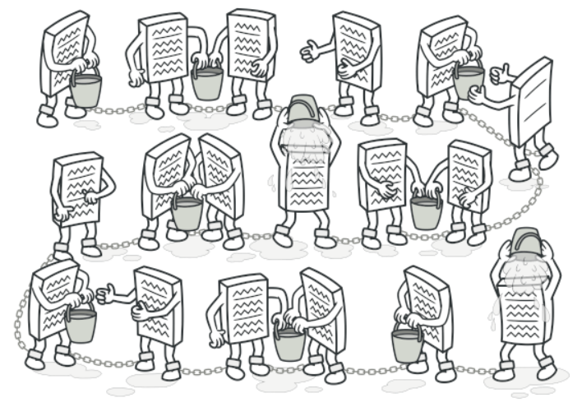
Chain of Responsibility
Definition
A behavioral design pattern that lets you pass requests along a chain of handlers. Upon receiving a request, each handler decides either to process the request or to pass it to the next handler in the chain.
Participants
The classes and objects participating in this pattern are:
Handler
defines an interface for handling the requests
ConcreteHandler
handles requests it is responsible for
can access its successor
if the ConcreteHandler can handle the request, it does so; otherwise it forwards the request to its successor
Client
initiates the request to a ConcreteHandler object on the chain
Applicability
Use the Chain of Responsibility pattern when your program is expected to process different kinds of requests in various ways, but the exact types of requests and their sequences are unknown beforehand.

Slide 3
Decorator
Definition
A structural design pattern that lets you attach new behaviors to objects by placing these objects inside special wrapper objects that contain the behaviors.
Participants
The classes and objects participating in this pattern are:
Component
defines the interface for objects that can have responsibilities added to them dynamically.
Concrete Component
defines an object to which additional responsibilities can be attached.
Decorator
maintains a reference to a Component object and defines an interface that conforms to Component's interface.
Concrete Decorator
adds responsibilities to the component.
Applicability
Use the Decorator pattern when you need to be able to assign extra behaviors to objects at runtime without breaking the code that uses these objects.
Use the pattern when it’s awkward or not possible to extend an object’s behavior using inheritance.

Slide 4
Open and Close
Definition
Software entities like classes, modules and functions should be open for extension but closed for modifications.

Slide 5
Adapter
Definition
Adapter is a structural design pattern that allows objects with incompatible interfaces to collaborate.
Participants
The classes and objects participating in this pattern are:
Target
defines the domain-specific interface that Client uses.
Adapter
adapts the interface Adaptee to the Target interface.
Adaptee
defines an existing interface that needs adapting.
Client
collaborates with objects conforming to the Target interface.

